Slide 1



PEILab Group Meeting
Leader: Zicong Hong
Team Member: Jian Lin, Haodong Wang, Qianli Liu, Kaibin Guo, Junjie Liu

Slide 2
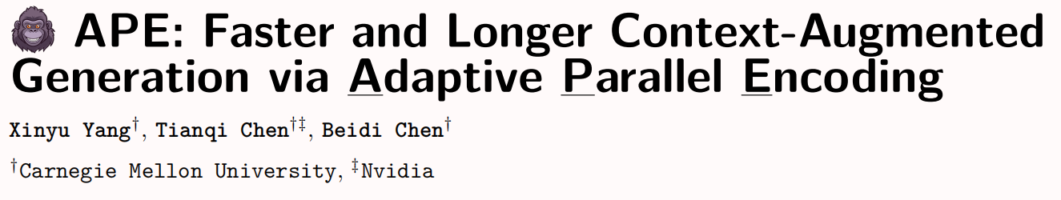
APE
ICLR’25

Slide 3
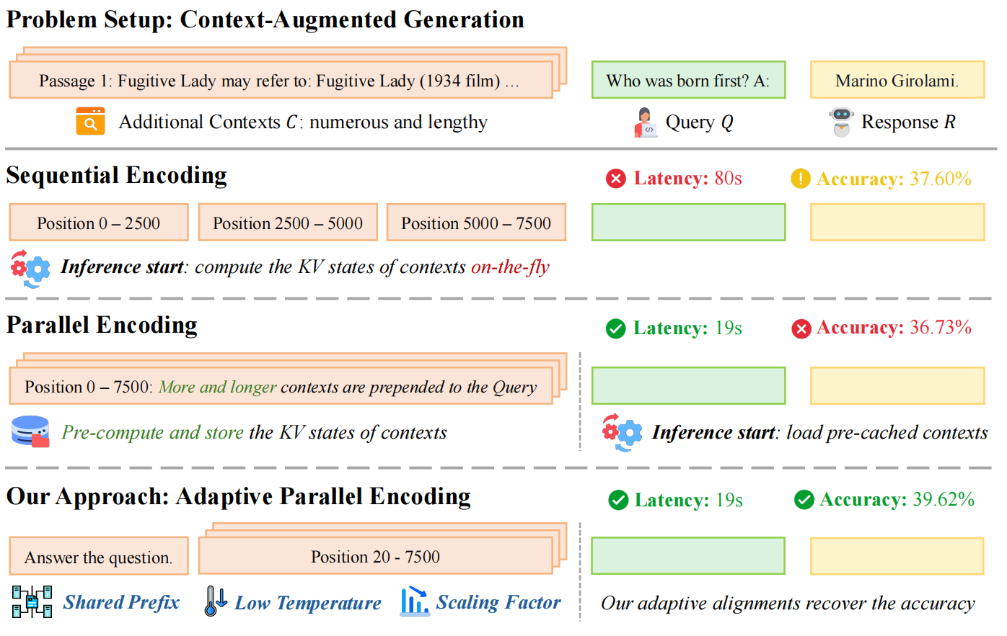
APE
Notes:
concatenating the retrieved texts into one sequence, and encoding the sequence into key-value (KV) states as the context for subsequent queries. While this new, significantly longer input improves performance, the increased latency in context prefilling becomes a bottleneck in tasks that require long inputs but generate short outputs (Bai et al., 2023; Agarwal et al., 2024; Jiang et al., 2024b).
Since texts for CAG are typically stored independently in external databases (Zayarni et al., 2024; Douze et al., 2024), pre-caching all these texts for direct loading during inference offers a brute-force approach to accelerate CAG. However, for autoregressive LLMs, the KV states are inherently context-dependent. This dependency makes naive pre-caching impractical, as it would require caching all possible context permutations, leading to factorial growth in memory requirements as the database size increases.
To address this issue, parallel encoding (Ratner et al., 2022; Yen et al., 2024; Li et al., 2024; Sun et al., 2024)
is introduced to encode each context into KV states separately, ensuring that tokens from different contexts
cannot attend to each other during encoding. Next, the on-the-fly generation starts by prefilling user queries,
which can attend to the cached KV states from all contexts without re-encoding, offering two benefits:

Slide 4
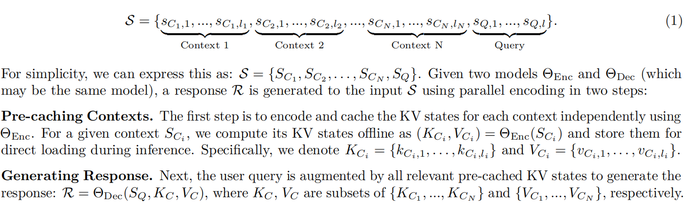
APE

Slide 5
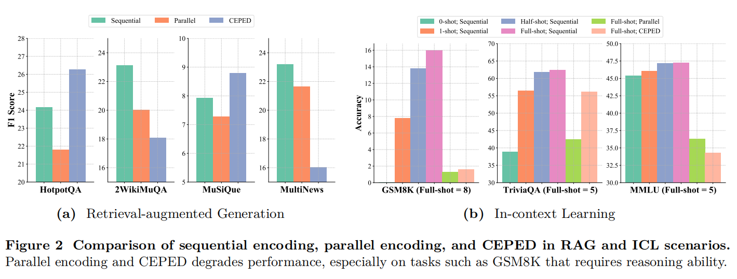
APE
Notes:
Despite these advantages, parallel encoding leads to significant performance degradation across multiple RAG and ICL scenarios, as shown in Figure 2, with average declines of 4.9% (despite using 2-10× more contexts) and 49.0%, respectively
highlighting the limitations of trainable approaches in generalizing to complex reasoning tasks.

Slide 6
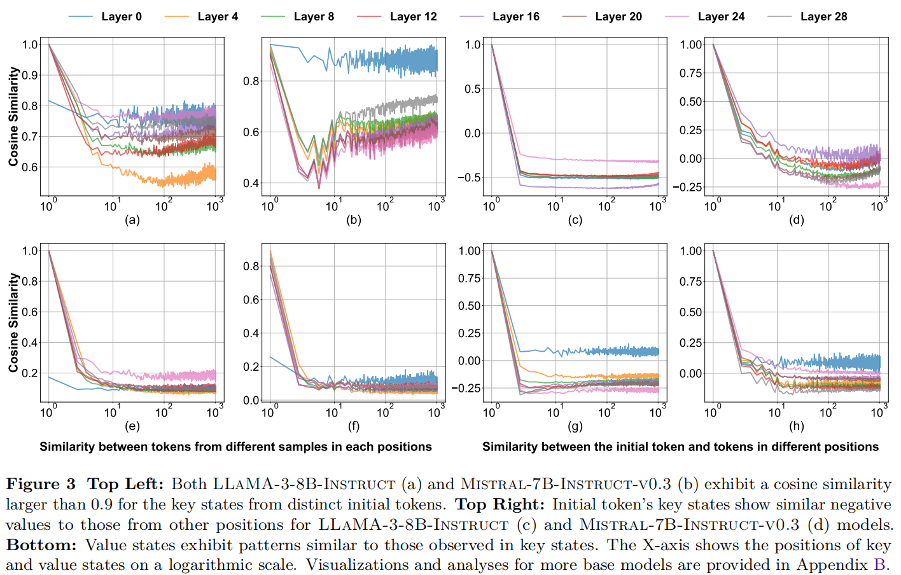
APE

Slide 7
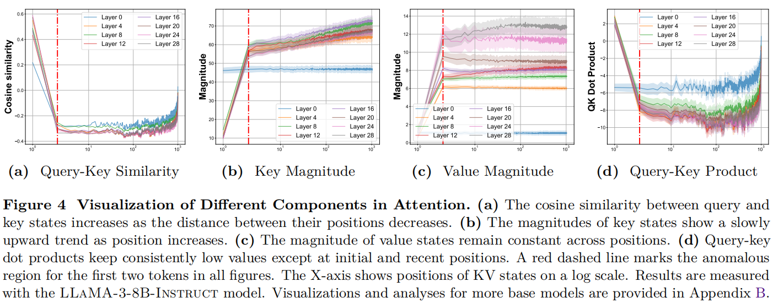
APE

Slide 8
APE

